Slide 1


Since 2011
Our outcomes are over 5000 trainees.
Get IT Right from RIG

Slide 2

Artificial Intelligence Engineering
(Level-1)
Module 1
Learn, Create, and Shine
Digital Space

Slide 3
Content
Module 1: Introduction to AI and Machine Learning
Module 2: Linear Algebra, Statistics and Probability for AI
Module 3: Neural Network Architecture
Module 4: Building Machine Learning Models
Module 5: Deep Learning Concepts
Module 6: Python Data Structure
Module 7: Data Handling with Pandas and NumPy
Module 8: Python for AI
Module 9: Classification AI Project
Module 10: Prediction AI Project

Slide 4
Artificial Intelligence Engineering
(Level-1)
Module 4: Building Machine Learning Models

Slide 5
Content
What is Machine Learning
Types of Machine Learning
Supervised Learning
How Supervised Learning Works
Unsupervised Learning
How Unsupervised Learning Works
Reinforcement Learning
How Reinforcement Learning Works
How to build Machine Learning Model

Slide 6
Learning Outcomes
What is Machine Learning: Understand the core concept of machine learning and its role in enabling systems to learn from data and make predictions.
Types of Machine Learning: Differentiate between supervised, unsupervised, and reinforcement learning paradigms.
Supervised Learning: Learn how supervised learning uses labeled data for training models to make accurate predictions.
How Supervised Learning Works: Explore the workflow of supervised learning, including data preprocessing, model training, and evaluation.
Unsupervised Learning: Understand the purpose of unsupervised learning in discovering hidden patterns and structures in unlabeled data.

Slide 7
Learning Outcomes
How Unsupervised Learning Works: Gain insight into the working mechanism of clustering, dimensionality reduction, and association rule techniques.
Reinforcement Learning: Learn about reinforcement learning and its applications in decision-making and control problems.
How Reinforcement Learning Works: Understand the interaction between agents and environments, including rewards, policies, and value functions.
How to Build a Machine Learning Model: Develop skills to create a machine learning pipeline, including data preparation, feature selection, and model building.
Practical Applications: Apply machine learning knowledge to real-world problems across diverse domains such as healthcare, finance, and robotics.

Slide 8

What is Machine Learning?
A field of Artificial Intelligence (AI) that focuses on enabling machines to learn from data and improve their performance over time.
In ML, machines are trained to find patterns, make predictions, or solve tasks by analyzing large datasets.
Notes:
ML (Machine Learning) is a branch of AI that enables machines to learn from data, identify patterns, and improve their performance over time without explicit programming.

Slide 9
Traditional Programming vs Machine Learning

Slide 10
Definition and Approach
 | Traditional Programming | Machine Learning
Definition | Explicitly coding rules and instructions to solve problems | Building systems that learn patterns from data to make predictions or decisions.
Input | Rules (Logic) + Data -> Program Output | Data + Output (Labeled/ Unlabeled) -> Learn rules (Model)
Output | The program generates outputs based on predefined rules. | The system “learns” rules automatically to generate predictions.
Notes:
ML (Machine Learning) is a branch of AI that enables machines to learn from data, identify patterns, and improve their performance over time without explicit programming.

Slide 11
Process
 | Traditional Programming | Machine Learning
Rules Creation | Programmers write specific instructions. | Algorithms learn rules from data.
Dependency | Relies on human expertise to write logic | Relies on data and learning algorithms.
Adaptability | Hard to adapt to new situations (requires reprogramming) | Can adapt automatically as new data is provided.
Notes:
ML (Machine Learning) is a branch of AI that enables machines to learn from data, identify patterns, and improve their performance over time without explicit programming.

Slide 12
Problem Solving
 | Traditional Programming | Machine Learning
Complex Problems | Difficult to handle unstructured data like images or text. | Excels in solving complex problems with data patterns
Rule-based Systems | Suitable for well-defined problems. | Suitable for problems where rules are unknown.
Notes:
ML (Machine Learning) is a branch of AI that enables machines to learn from data, identify patterns, and improve their performance over time without explicit programming.

Slide 13
Data Usage
 | Traditional Programming | Machine Learning
Data Requirements | Uses predefined rules; does not reply on data. | Requires large amounts of data to learn patterns
Example | Input/ output is static and fixed. | Input/output is dynamic and based on training data.
Notes:
ML (Machine Learning) is a branch of AI that enables machines to learn from data, identify patterns, and improve their performance over time without explicit programming.

Slide 14
Errors and Debugging
 | Traditional Programming | Machine Learning
Errors | Debugging involves identifying logical errors in code. | Errors depend on data quality and model design.
Performance | If logic is correct, results are deterministic. | Performance depends on training data and model accuracy.
Notes:
ML (Machine Learning) is a branch of AI that enables machines to learn from data, identify patterns, and improve their performance over time without explicit programming.

Slide 15
Learning and Improvement
 | Traditional Programming | Machine Learning
Learning Process | No learning; fixed instructions. | The model improves its accuracy by learning from data.
Adaption | Requires manual modification of the code. | Learns and adapts automatically to new data.
Notes:
ML (Machine Learning) is a branch of AI that enables machines to learn from data, identify patterns, and improve their performance over time without explicit programming.

Slide 16
Importance of Machine Learning
Automation: Machines can perform tasks without constant human intervention.
Data-Driven Decisions: ML models analyze large amounts of data and extract actionable insights.
Improved Accuracy: With sufficient data and good models, machines can outperform humans on specific tasks.
Scalability: ML solutions can process vast amounts of data quickly.
Notes:
ML (Machine Learning) is a branch of AI that enables machines to learn from data, identify patterns, and improve their performance over time without explicit programming.

Slide 17
Use Cases of Machine Learning
Healthcare: Diagnosing diseases based on medical images.
E-commerce: Personalized product recommendations.
Finance: Fraud detection in credit card transactions.
Self-Driving Cars: Learning to navigate by analyzing sensor data.
Voice Assistants: Recognizing speech and answering questions (Alexa, Siri).
Notes:
ML (Machine Learning) is a branch of AI that enables machines to learn from data, identify patterns, and improve their performance over time without explicit programming.

Slide 18
Types of Machine Learning
Supervised Learning
Unsupervised Learning
Reinforcement Learning
Training a model using labeled data.
Finding patterns in data without predefined labels.
Learning through rewards and penalties.
Popular Use Cases: Examples include image recognition, spam filtering, recommendation systems, and language translation.
Notes:
This slide introduces the three primary types of learning methods in Artificial Intelligence (AI): Supervised Learning, Unsupervised Learning, and Reinforcement Learning.​
Supervised Learning​
Definition: A type of machine learning where the model is trained on labeled data (input-output pairs).​
Unsupervised Learning​
Definition: A type of machine learning where the model is given unlabeled data and must find patterns or structures within the data.​
Reinforcement Learning​
Definition: A learning method where an agent learns by interacting with its environment and receiving feedback in the form of rewards or penalties.

Slide 19
Supervised Learning
Definition
Learning from labeled data to make predictions.
Examples
Email Spam Detection (Classification)
House Price Prediction (Regression)
Popular Algorithms
Linear Regression, Decision Trees, Support Vector Machines (SVM)
Notes:
Definition, Example and Popular Algorithms of Supervised Learning.
Spam Email Detection:
Input: Email content.
Output: Spam or Not Spam.
Credit Card Fraud Detection:
Input: Transaction details.
Output: Fraud or Legitimate.
Medical Diagnosis:
Input: Patient symptoms and test results.
Output: Disease diagnosis.
House Price Prediction:
Input: Size of house, location, etc.
Output: Predicted house price.

Slide 20
Benefits of Supervised Learning
Clear Objective - Since data is labeled, the learning process has a clear target.
Accurate Predictions - Supervised learning can deliver high accuracy if the data quality is good.
Handles Real-World Problems - Many real-world problems like fraud detection, recommendation systems, and medical diagnostics fit well into the supervised learning framework.
Easily Interpretable - Results from supervised models are often explainable (e.g., decision trees, linear regression).
Improves with Data - More labeled data allows the model to improve and generalize better.
Notes:
ML (Machine Learning) is a branch of AI that enables machines to learn from data, identify patterns, and improve their performance over time without explicit programming.

Slide 21

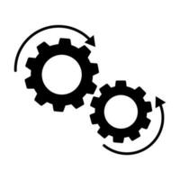

How Supervised Learning Works?
Step 1: Collect Labeled Data
Step 2: Split into Training and Testing Sets
Step 3: Train the Model
Step 4: Test & Evaluate Performance
Outputs
Test Data
Labeled Data
Supervisor
Training Data Sets
triangle
circle
Processing
hexagon
triangle
Model Training
circle
hexagon
Labels
Notes:
Step by step of How Supervised Learning Works.
Steps to Train a Supervised Learning Model
Here’s a step-by-step guide:
Define the Problem:
Decide if the problem is a regression or classification task.
Collect and Prepare Data:
Gather labeled data (inputs and outputs).
Example: For house price prediction:
Size (sq ft)
Location
Price (label)
1200
A
$200,000
1500
B
$250,000
Data Preprocessing:
Clean the Data: Remove missing values and outliers.
Normalize or Scale: Scale input features to ensure they are in the same range.
Train-Test Split: Split data into:
Training Set: 80% of the data used for training.
Testing Set: 20% used for evaluation.
Choose the Right Algorithm:
For Regression: Linear Regression, Polynomial Regression.
For Classification: Logistic Regression, Support Vector Machines, Decision Trees.
Train the Model:
Fit the model to the training data: Model←Algorithm(Xtrain,Ytrain)\text{Model} \leftarrow \text{Algorithm} (X_{\text{train}}, Y_{\text{train}})Model←Algorithm(Xtrain ,Ytrain )
The algorithm optimizes parameters (e.g., weights in Linear Regression) to minimize prediction errors.
Evaluate the Model:
Use metrics to measure performance:
Regression: Mean Squared Error (MSE), R².
Classification: Accuracy, Precision, Recall, F1-score.
Optimize and Tune Hyperparameters:
Improve the model by tuning parameters like learning rate, model depth, etc.
Deploy and Predict:
Use the trained model to make predictions on new data.

Slide 22
Steps to Train Supervised Learning Model

Slide 23
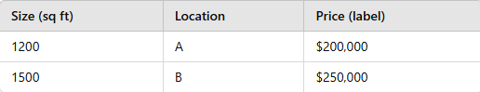
Step 1
Define the Problem
Decide if the problem is a regression or classification task.
Step 2
Collect and Prepare Data
Gather labeled data (inputs and outputs)
Step 3
Data Preprocessing
Clean the Data: Remove missing values and outliers.
Normalize or Scale: Scale input features to ensure they are in the same range.
Train-Test Split: Split data
Training Set: 80% of the data used for training.
Testing Set: 20% used for evaluation.
Notes:
Steps to Train a Supervised Learning Model
Here’s a step-by-step guide:
Define the Problem:
Decide if the problem is a regression or classification task.
Collect and Prepare Data:
Gather labeled data (inputs and outputs).
Example: For house price prediction:Size (sq ft)LocationPrice (label)1200A$200,0001500B$250,000
Data Preprocessing:
Clean the Data: Remove missing values and outliers.
Normalize or Scale: Scale input features to ensure they are in the same range.
Train-Test Split: Split data into:
Training Set: 80% of the data used for training.
Testing Set: 20% used for evaluation.
Choose the Right Algorithm:
For Regression: Linear Regression, Polynomial Regression.
For Classification: Logistic Regression, Support Vector Machines, Decision Trees.
Train the Model:
Fit the model to the training data: Model←Algorithm(Xtrain,Ytrain)\text{Model} \leftarrow \text{Algorithm} (X_{\text{train}}, Y_{\text{train}})Model←Algorithm(Xtrain​,Ytrain​)
The algorithm optimizes parameters (e.g., weights in Linear Regression) to minimize prediction errors.
Evaluate the Model:
Use metrics to measure performance:
Regression: Mean Squared Error (MSE), R².
Classification: Accuracy, Precision, Recall, F1-score.
Optimize and Tune Hyperparameters:
Improve the model by tuning parameters like learning rate, model depth, etc.
Deploy and Predict:
Use the trained model to make predictions on new data.

Slide 24
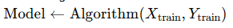
Step 4
Choose the Right Algorithm
For Regression: Linear Regression, Polynomial Regression.
For Classification: Logistic Regression, Support Vector Machines, Decision Trees.
Step 5
Train the Model
Fit the model to the training data.
The algorithm optimizes parameters to minimize prediction errors.
Notes:
Steps to Train a Supervised Learning Model
Here’s a step-by-step guide:
Define the Problem:
Decide if the problem is a regression or classification task.
Collect and Prepare Data:
Gather labeled data (inputs and outputs).
Example: For house price prediction:Size (sq ft)LocationPrice (label)1200A$200,0001500B$250,000
Data Preprocessing:
Clean the Data: Remove missing values and outliers.
Normalize or Scale: Scale input features to ensure they are in the same range.
Train-Test Split: Split data into:
Training Set: 80% of the data used for training.
Testing Set: 20% used for evaluation.
Choose the Right Algorithm:
For Regression: Linear Regression, Polynomial Regression.
For Classification: Logistic Regression, Support Vector Machines, Decision Trees.
Train the Model:
Fit the model to the training data: Model←Algorithm(Xtrain,Ytrain)\text{Model} \leftarrow \text{Algorithm} (X_{\text{train}}, Y_{\text{train}})Model←Algorithm(Xtrain​,Ytrain​)
The algorithm optimizes parameters (e.g., weights in Linear Regression) to minimize prediction errors.
Evaluate the Model:
Use metrics to measure performance:
Regression: Mean Squared Error (MSE), R².
Classification: Accuracy, Precision, Recall, F1-score.
Optimize and Tune Hyperparameters:
Improve the model by tuning parameters like learning rate, model depth, etc.
Deploy and Predict:
Use the trained model to make predictions on new data.

Slide 25
Step 6
Evaluate the Model
Use metrics to measure performance
Regression: Mean Squared Error (MSE), R².
Classification: Accuracy, Precision, Recall, F1-score.
Step 7
Optimize and Tune Hyperparameters
Improve the model by tuning parameters like learning rate, model depth, etc.
Step 8
Deploy and Predict
Use the trained model to make predictions on new data.
Notes:
Steps to Train a Supervised Learning Model
Here’s a step-by-step guide:
Define the Problem:
Decide if the problem is a regression or classification task.
Collect and Prepare Data:
Gather labeled data (inputs and outputs).
Example: For house price prediction:Size (sq ft)LocationPrice (label)1200A$200,0001500B$250,000
Data Preprocessing:
Clean the Data: Remove missing values and outliers.
Normalize or Scale: Scale input features to ensure they are in the same range.
Train-Test Split: Split data into:
Training Set: 80% of the data used for training.
Testing Set: 20% used for evaluation.
Choose the Right Algorithm:
For Regression: Linear Regression, Polynomial Regression.
For Classification: Logistic Regression, Support Vector Machines, Decision Trees.
Train the Model:
Fit the model to the training data: Model←Algorithm(Xtrain,Ytrain)\text{Model} \leftarrow \text{Algorithm} (X_{\text{train}}, Y_{\text{train}})Model←Algorithm(Xtrain​,Ytrain​)
The algorithm optimizes parameters (e.g., weights in Linear Regression) to minimize prediction errors.
Evaluate the Model:
Use metrics to measure performance:
Regression: Mean Squared Error (MSE), R².
Classification: Accuracy, Precision, Recall, F1-score.
Optimize and Tune Hyperparameters:
Improve the model by tuning parameters like learning rate, model depth, etc.
Deploy and Predict:
Use the trained model to make predictions on new data.

Slide 26
Challenges of Supervised Learning
Requires Labeled Data
Obtaining high-quality labeled data can be expensive and time-consuming.
Overfitting
The model may perform well on training data but poorly on new data.
Solution: Use techniques like cross-validation and regularization.
Data Bias
If the training data is biased, the model may produce biased predictions.
Scalability
Training on large datasets may require significant computational resources.
Notes:
ML (Machine Learning) is a branch of AI that enables machines to learn from data, identify patterns, and improve their performance over time without explicit programming.

Slide 27
Unsupervised Learning
Definition
Examples
Customer Segmentation (Clustering)
Anomaly Detection (Outlier Detection)
Popular Algorithms
k-Means Clustering, Principal Component Analysis (PCA), Hierarchical Clustering
Finding patterns in data without labels.
Notes:
Definition, Example and Popular Algorithms of Unsupervised Learning.
Types of Unsupervised Learning
Clustering:
Groups similar data points into clusters based on their characteristics.
Goal: Identify groups (clusters) within the data.
Examples:
Customer segmentation.
Grouping documents by topics.
Algorithms: K-Means, DBSCAN, Hierarchical Clustering.
Dimensionality Reduction:
Reduces the number of features (dimensions) in the dataset while preserving its important information.
Goal: Simplify the data for better visualization or analysis.
Examples:
Reducing image data dimensions for faster processing.
Visualizing high-dimensional datasets using 2D or 3D plots.
Algorithms: Principal Component Analysis (PCA), t-SNE, Autoencoders

Slide 28
Benefits of Unsupervised Learning
No Need for Labeled Data
Unsupervised learning works with unlabeled data, which is cheaper and easier to collect.
Identifies Hidden Patterns
It helps discover structures or patterns in the data that may not be obvious.
Useful for Large Datasets
Unsupervised learning scales well and is ideal for analyzing large, complex datasets.
Feature Reduction
Reduces data complexity while retaining key features, which improves processing efficiency.
Insights and Anomaly Detection
Can detect unusual data points (anomalies) in a dataset, like fraud detection or fault detection.
Notes:
ML (Machine Learning) is a branch of AI that enables machines to learn from data, identify patterns, and improve their performance over time without explicit programming.

Slide 29
How Unsupervised Learning Works?
Step 1: Input Unlabeled Data
Step 2: Apply Clustering/Dimensionality Reduction
Step 3: Discover Patterns or Groups
Unlabeled Data
Clustered Data
Y
Y
Clustering
X
X
Notes:
Step by step of How Unsupervised Learning Works by applying clustering method.

Slide 30
Steps to Train Unsupervised Learning Model
Clustering with K-Means

Slide 31
Step 1
Define the Problem
Understand the purpose of clustering
Group customers into clusters based on their purchasing behavior, income, or spending score
Step 2
Collect and Prepare Data
Gather the dataset without labels (no target variable)
Customer data, web activity logs, or sensor readings
Step 3
Data Preprocessing
Handle Missing Values
Remove Outliers
Scale/Normalize Features
Scale features to ensure they contribute equally to the model
Min-Max Scaling or Standardization
Notes:
Steps to Train an Unsupervised Learning Model (Clustering with K-Means)
1. Define the Objective
Understand the purpose of clustering.
Example: Group customers into clusters based on their purchasing behavior, income, or spending score.
2. Collect and Prepare the Data
Gather the dataset without labels (no target variable).
Example: Customer data, web activity logs, or sensor readings.
Data Preprocessing:
Handle Missing Values: Remove or impute missing data.
Remove Outliers: Outliers may distort clustering results.
Scale/Normalize Features:
Scale features to ensure they contribute equally to the model.
Use methods like Min-Max Scaling or Standardization.
Example of Features:
Feature 1: Annual IncomeFeature 2: Spending Score
3. Choose the Number of Clusters (k)
K-Means requires specifying the number of clusters kkk in advance.
Methods to determine kkk:
Elbow Method: Plot the sum of squared distances (inertia) for different values of kkk and look for the "elbow point" where adding more clusters doesn't significantly reduce the inertia.
Silhouette Score: Measures how well data points fit within their clusters. A higher score indicates better clustering.
4. Train the K-Means Model
Initialize kkk cluster centroids (randomly).
Assign each data point to the nearest cluster centroid (using Euclidean distance).
Update the centroids: Calculate the mean position of all points in each cluster.
Repeat until centroids stop changing significantly or a predefined number of iterations is reached.
Steps in Detail:
Assign points to the closest centroid.
Update centroids: Ci=1n∑j=1nXjC_i = \frac{1}{n} \sum_{j=1}^{n} X_jCi​=n1​j=1∑n​Xj​
CiC_iCi​: New centroid for cluster iii.
XjX_jXj​: Points in cluster iii.
Repeat until convergence.
5. Evaluate the Clusters
Measure the quality of clusters using metrics like:
Inertia (Within-Cluster Sum of Squares): Lower values indicate tighter clusters.
Silhouette Score: Measures how similar points are to their own cluster compared to other clusters.
Visualize the clusters using scatter plots (2D or 3D).
6. Interpret and Analyze Results
Examine the clusters to understand their meaning.
Example:
Cluster 1 → Low income, low spending.
Cluster 2 → High income, high spending.
Use insights to make decisions, such as targeted marketing or anomaly detection.
7. Optimize the Model (Optional)
Test different values of kkk to identify the optimal number of clusters.
Use dimensionality reduction (like PCA) if the dataset has high dimensionality to improve efficiency.
8. Deployment
Deploy the model to group incoming data (e.g., new customers).
Integrate into applications for continuous clustering and decision-making.
Summary of Steps
Define Objective: Understand the clustering goal.
Data Collection and Preparation: Handle missing values, scale the data.
Select the Number of Clusters: Use Elbow Method or Silhouette Score.
Train the K-Means Model: Assign points, update centroids, and iterate.
Evaluate the Clusters: Use inertia and silhouette scores.
Interpret Results: Analyze and derive insights.
Optimize: Adjust kkk or reduce dimensions.
Deploy: Use the model for future clustering tasks.

Slide 32
Step 4
Choose the Number of Clusters (k)
K-Means requires specifying the number of clusters 𝑘 in advance.
Elbow Method: Plot the sum of squared distances (inertia) for different values of 𝑘 and look for the "elbow point" where adding more clusters doesn't significantly reduce the inertia.
Silhouette Score: Measures how well data points fit within their clusters. A higher score indicates better clustering.
Notes:
ML (Machine Learning) is a branch of AI that enables machines to learn from data, identify patterns, and improve their performance over time without explicit programming.

Slide 33
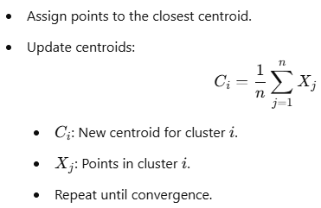
Step 5
Train the Model
Initialize 𝑘 cluster centroids (randomly).
Assign each data point to the nearest cluster centroid (using Euclidean distance)
Update the centroids: Calculate the mean position of all points in each cluster.
Repeat until centroids stop changing significantly or a predefined number of iterations is reached.
Notes:
ML (Machine Learning) is a branch of AI that enables machines to learn from data, identify patterns, and improve their performance over time without explicit programming.

Slide 34
Step 6
Evaluate the Clusters
Measure the quality of clusters using metrics
Inertia (Within-Cluster Sum of Squares): Lower values indicate tighter clusters.
Silhouette Score: Measures how similar points are to their own cluster compared to other clusters.
Visualize the clusters using scatter plots (2D or 3D).
Notes:
ML (Machine Learning) is a branch of AI that enables machines to learn from data, identify patterns, and improve their performance over time without explicit programming.

Slide 35
Step 7
Interpret and Analyze Results
Examine the clusters to understand their meaning.
Cluster 1 → Low income, low spending.
Cluster 2 → High income, high spending.
Use insights to make decisions, such as targeted marketing or anomaly detection.
Notes:
ML (Machine Learning) is a branch of AI that enables machines to learn from data, identify patterns, and improve their performance over time without explicit programming.

Slide 36
Step 8
Optimize the Model
Test different values of 𝑘 to identify the optimal number of clusters.
Use dimensionality reduction (PCA) if the dataset has high dimensionality to improve efficiency.
Step 9
Deployment
Deploy the model to group incoming data (new customers).
Integrate into applications for continuous clustering and decision-making.
Notes:
ML (Machine Learning) is a branch of AI that enables machines to learn from data, identify patterns, and improve their performance over time without explicit programming.

Slide 37
Reinforcement Learning
Definition
Examples
Game AI (AlphaGo)
Robotics (Path Optimization)
Key Concepts
Agent, Environment, Rewards, Actions
Learning through rewards and penalties in a trial-and-error fashion.
Notes:
Definition, Example and Key Concepts of Reinforcement Learning.

Slide 38
How Reinforcement Learning Works?
Step 1: Agent interacts with the environment.
Step 2: Receives rewards or penalties.
Step 3: Learns to maximize rewards over time.
Action
Input Raw Data
Agent
Environment
Output
Rewards or Penalties
Notes:
Step by step of How Reinforcement Learning Works by using input raw data.

Slide 39

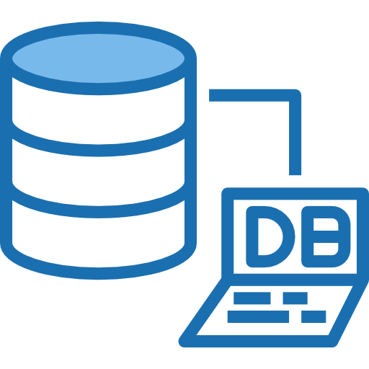

How to build Machine Learning Model?
Understanding the Machine Learning Workflow
Step 1: Data Collection Gathering data from sources like CSV files, databases, or web scraping.
Notes:
Images of csv files, databases and web scraping for data collection to build machine learning model.

Slide 40
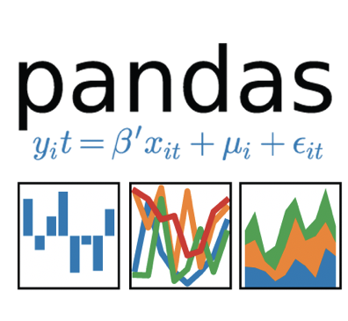
Step 2: Data Preprocessing
Handling missing values, normalizing data, and converting categorical variables.
Tools: pandas for data manipulation.
Handling missing values
Normalizing Data
Converting categorical variables
import pandas as pd
Notes:
Pandas data manipulation is the process of cleaning, transforming, and aggregating data using the Pandas library

Slide 41
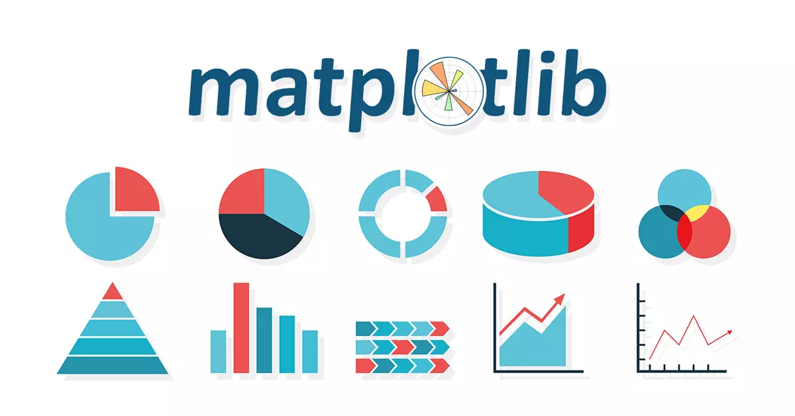
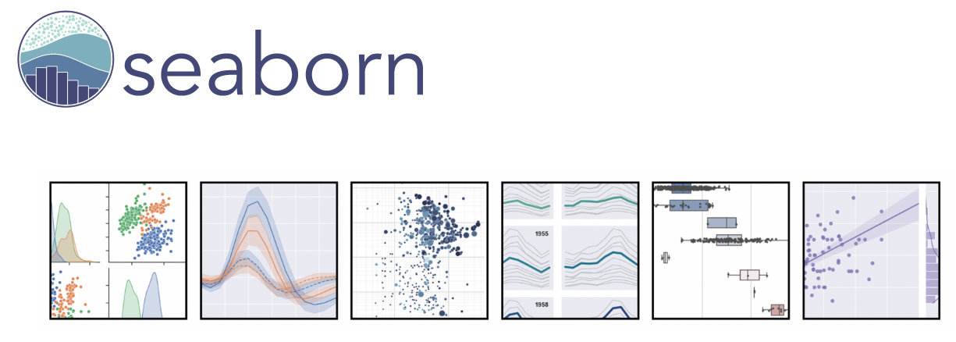
Step 3: Exploratory Data Analysis (EDA)
Using matplotlib and seaborn for visualizing data patterns.
import matplotlib.pyplot as pd
import seaborn as sns
Notes:
Image of matplotlib and seaborn using in Python.
Matplotlib is a low level graph plotting library in python that serves as a data visualization utility. On the other hand, Seaborn is a higher level data visualization library based on matplotlib. When it comes to visualization, we can set some rules based on the data type.

Slide 42
Step 4: Model Building
Splitting data into training and testing sets.
Choosing the right algorithm for your problem.
Testing Data Sets
Training Data Sets
Algorithm
Model
Notes:
The diagram of model building with training and testing data sets by choosing the right algorithm for the given problem.

Slide 43
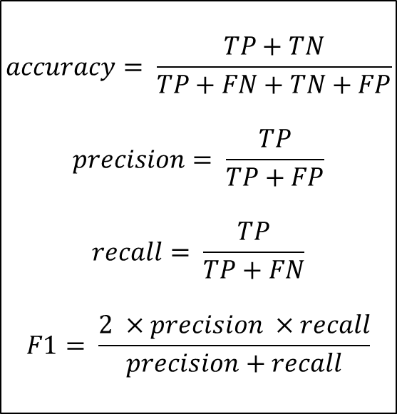
Step 5: Model Evaluation
Metrics: Accuracy, Precision, Recall, F1-score, Confusion Matrix.
Equations:
$$accuracy= \frac{TP+TN}{TP+FN+TN+FP}$$
$$precision= \frac{TP}{TP+FP}$$
$$recall= \frac{TP}{TP+FN}$$
$$F1= \frac{2 ×precision ×recall}{precision+recall}$$
 | Predicted Positive | Predicted Negative
Actual Positive | TP | FN
Actual Negative | FP | TN
True Positive (TP): Correctly predicted positive cases
True Negative (TN): Correctly predicted negative cases
False Positive (FP): Incorrectly predicted positive cases
False Negative (FN): Incorrectly predicted negative cases
Notes:
True Positive (TP): Correctly predicted positive cases
True Negative (TN): Correctly predicted negative cases
False Positive (FP): Incorrectly predicted positive cases
False Negative (FN): Incorrectly predicted negative cases
Confusion Matrix: It provides a detailed breakdown of where your model is performing well and where it is making mistakes. Helps balance the trade-offs between metrics like precision and recall, especially in imbalanced datasets.

Slide 44
Step 6: Hyperparameter Tuning
Techniques like Grid Search and Random Search.
x
x
y
y
z
z
a
b
c
c
a
b
Grid Search
Random Search
Notes:
Hyperparameter tuning is the process of optimizing the settings (hyperparameters) of a machine learning model to improve its performance. Hyperparameters are configurations set before training a model, such as the learning rate, number of layers, or regularization strength. Image show difference between Grid search and Random search Both Grid Search and Random Search are popular techniques for hyperparameter tuning, but they differ in how they explore the hyperparameter space.

Slide 45
Step 7: Model Deployment
Exporting models using joblib or pickle.
Deploying models using Flask or FastAPI.
from joblib import dump, load
import pickle
from flask import Flask, request,
josonify
from fastapi import FastAPI
Notes:
joblib is optimized for serializing large numpy arrays and is often preferred for machine learning models. pickle is a general-purpose serialization library that works for most Python objects, including machine learning models.
Flask is a lightweight framework ideal for small applications. Below is an example to deploy a model as a REST API.
FastAPI is a modern framework with built-in support for asynchronous operations, automatic validation, and documentation.

Slide 46


Realistic Infotech Group
IT Training & Services
No.79/A, First Floor
Corner of Insein Road and Damaryon Street
Quarter (9), Hlaing Township
Near Thukha Bus Station
09256675642, 09953933826
http://www.rig-info.com

